Slide 1
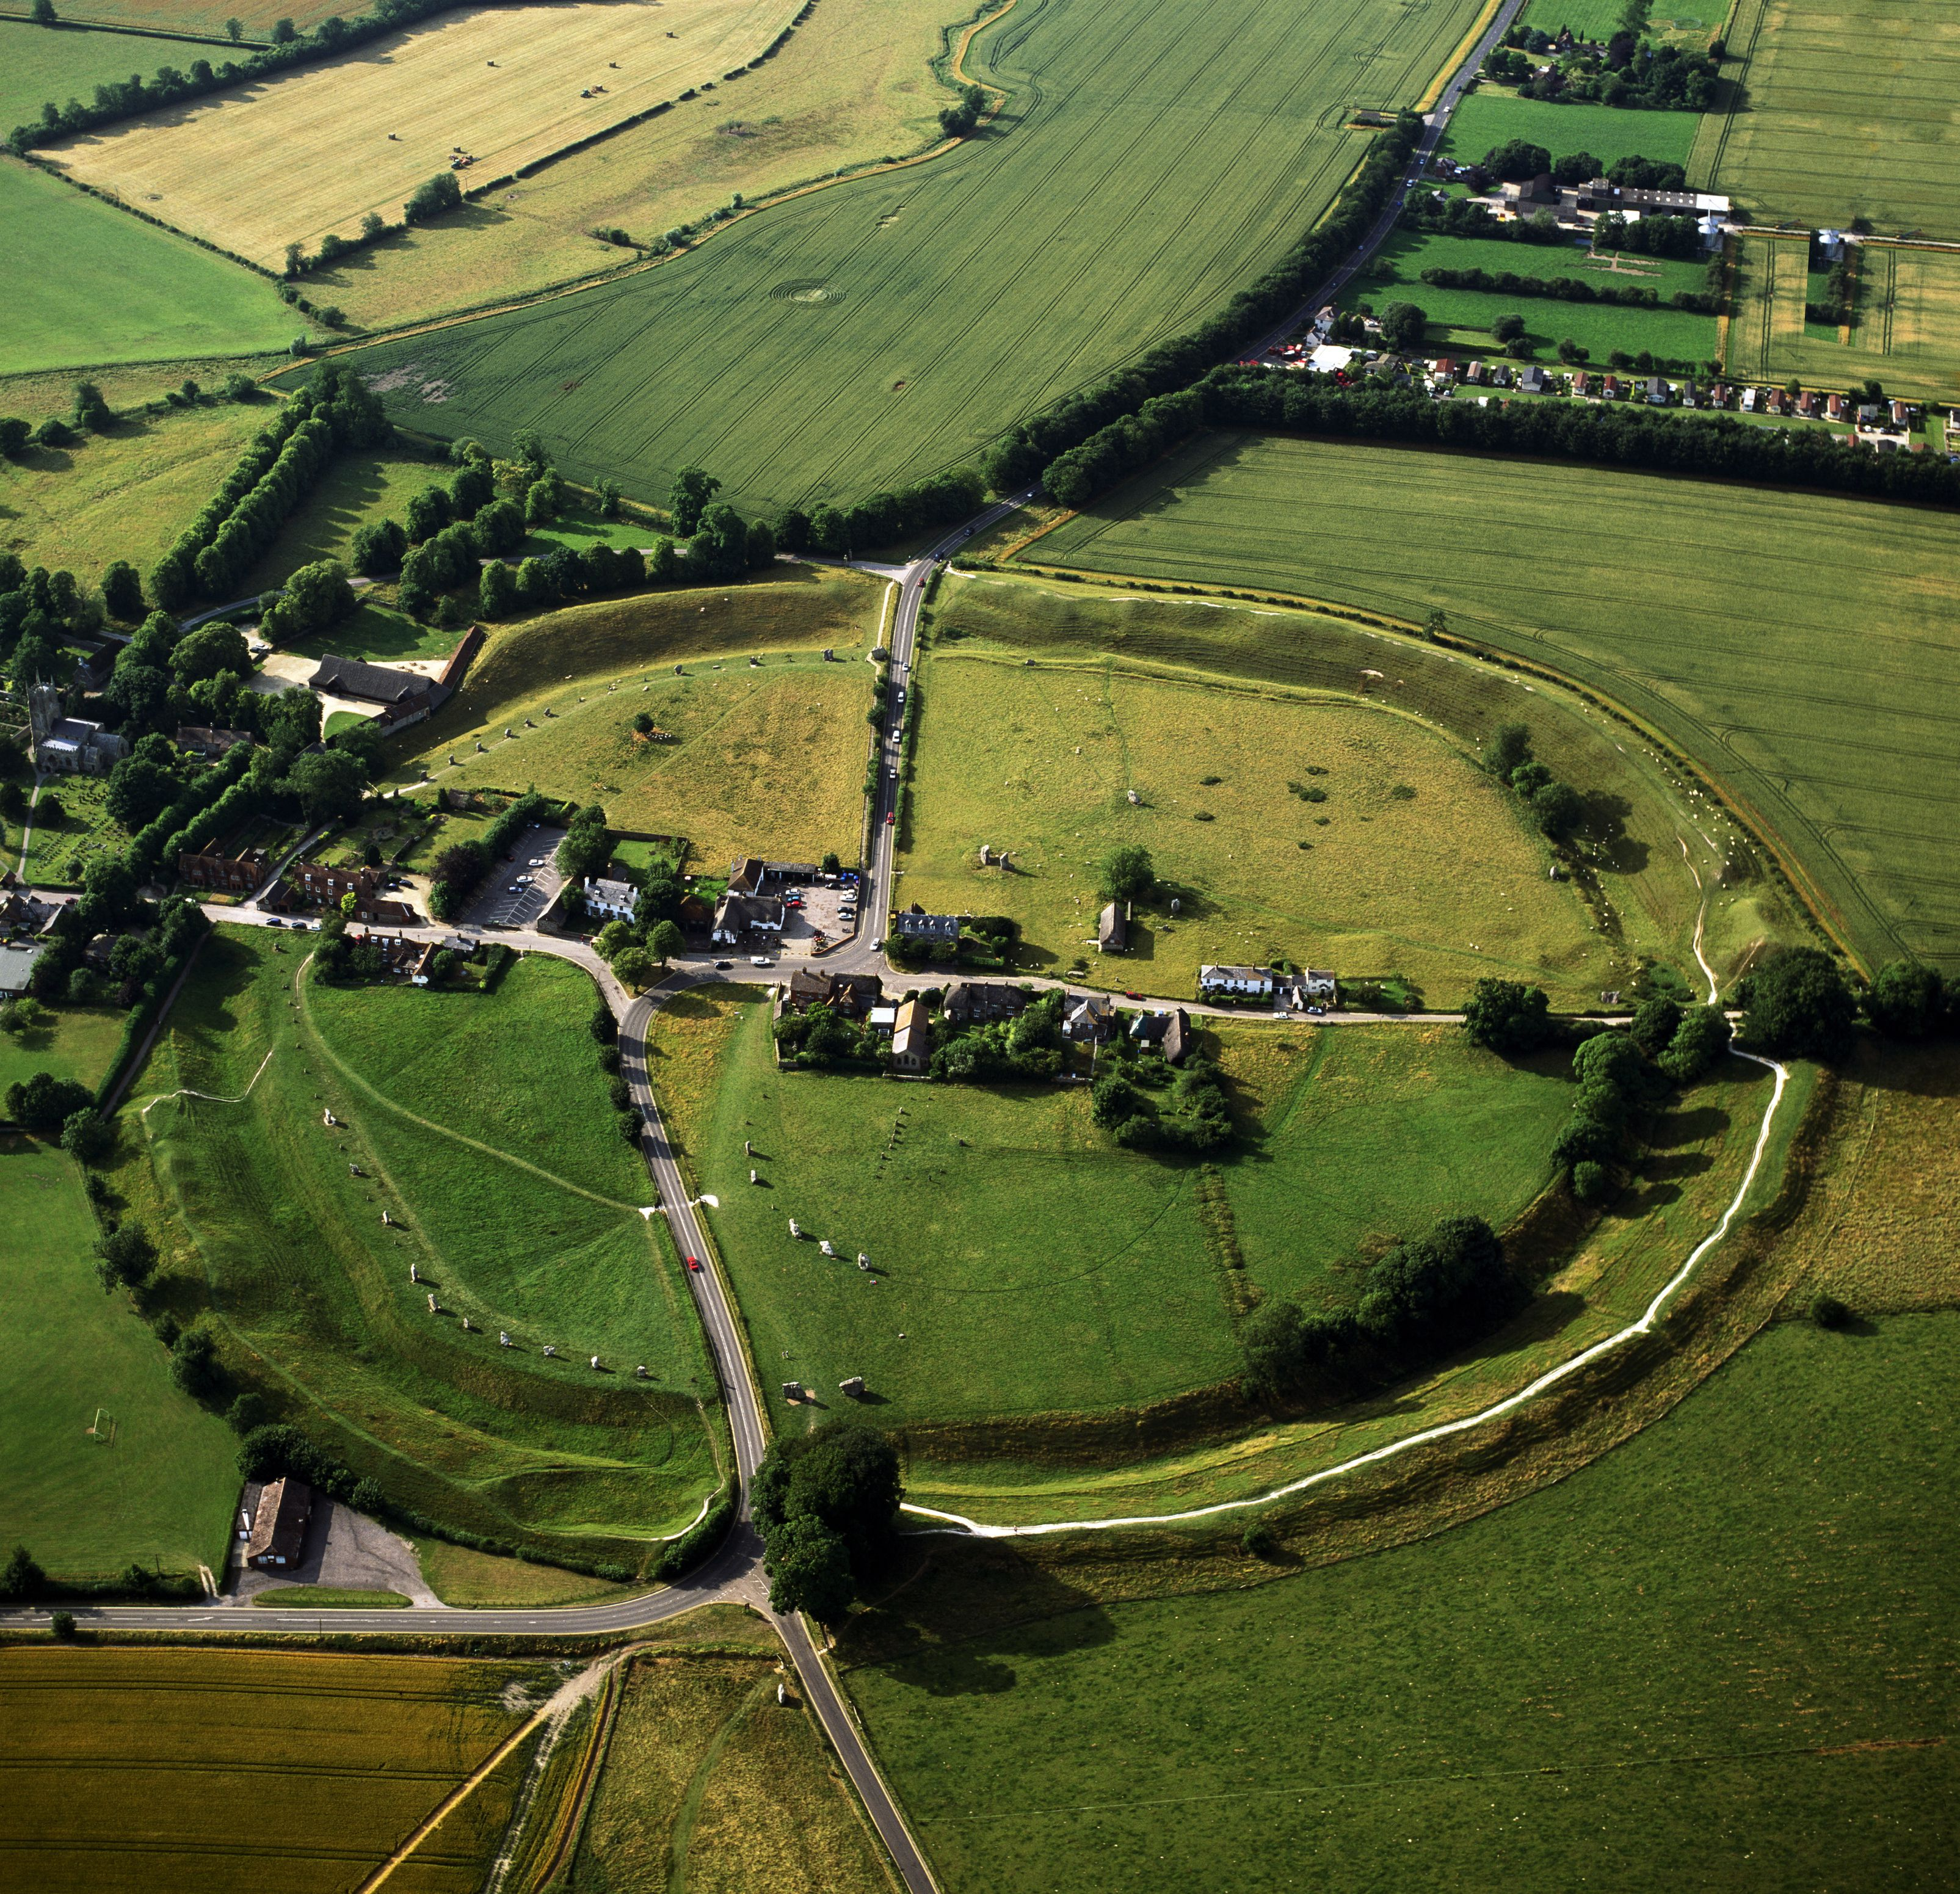
Avebury
Avebury had 100 stones and now has over 30 stones. Cavemen used logs, spears and ropes to lift the stones.

Slide 2
stones
The stones were five meters tail. Some of the stones are gone and that,s why thers 30.

Slide 3
facts
The stones are bumpy. The people were very strong.

Slide 4
Who moved the stones
    Cavemen gladiators or romans?

